Slide 1
Lecture 08
NEURAL NETWORKS

Slide 2
Learning Objectives
Understand the concept and different types of artificial neural networks (ANN)
Learn the advantages and limitations of ANN
Understand how backpropagation neural networks learn
Understand the complete process of using neural networks
Appreciate the wide variety of applications of neural networks

Slide 3
Basic Concepts of Neural Networks
Neural networks (NN) or artificial neural network (ANN)
Computer technology that attempts to build computers that will operate like a human brain. The machines possess simultaneous memory storage and works with ambiguous information

Slide 4
Basic Concepts of Neural Networks
Neural computing
An experimental computer design aimed at building intelligent computers that operate in a manner modeled on the functioning of the human brain. See artificial neural networks (ANN)
Perceptron
Early neural network structure that uses no hidden layer

Slide 5
Basic Concepts of Neural Networks
Biological and artificial neural networks
  Neurons
  Cells (processing elements) of a biological or artificial neural network
  Nucleus
  The central processing portion of a neuron
  Dendrite
  The part of a biological neuron that provides inputs to the cell

Slide 6
Basic Concepts of Neural Networks
Biological and artificial neural networks
  Axon
  An outgoing connection (i.e., terminal) from a biological neuron
  Synapse
  The connection (where the weights are) between processing elements in a neural network

Slide 7
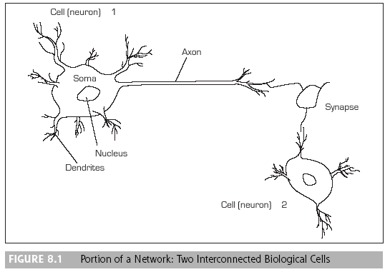
Basic Concepts of Neural Networks

Slide 8
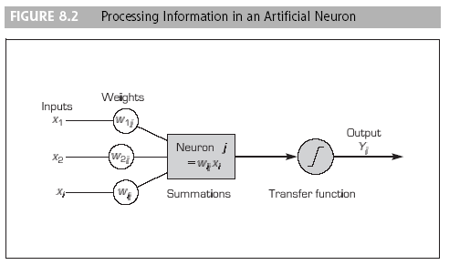
Basic Concepts of Neural Networks

Slide 9
Basic Concepts of Neural Networks
Elements of ANN
  Topologies
  The type neurons are organized in a neural network
  Backpropagation
  The best-known learning algorithm in neural computing. Learning is done by comparing computed outputs to desired outputs of historical cases

Slide 10
Basic Concepts of Neural Networks
  Processing elements (PEs)
  The neurons in a neural network
  Network structure (three layers)
    Input
    Intermediate (hidden layer)
    Output

Slide 11
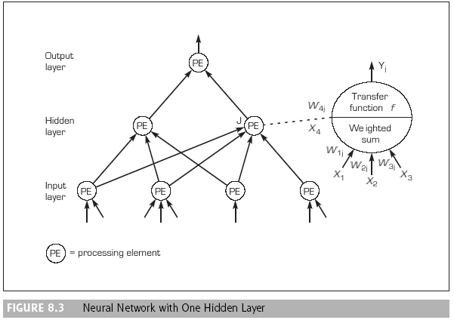
Basic Concepts of Neural Networks

Slide 12
Basic Concepts of Neural Networks
  Parallel processing
  An advanced computer processing technique that allows a computer to perform multiple processes at once—in parallel

Slide 13
Basic Concepts of Neural Networks
  Network information processing
    Inputs
    Outputs
    Connection weights
    Summation function or Transformation (transfer) function

Slide 14
Basic Concepts of Neural Networks
  Network information processing
    Connection weights
    The weight associated with each link in a neural network model. They are assessed by neural networks learning algorithms
    Summation function or transformation (transfer) function
    In a neural network, the function that sums and transforms inputs before a neuron fires. The relationship between the internal activation level and the output of a neuron

Slide 15
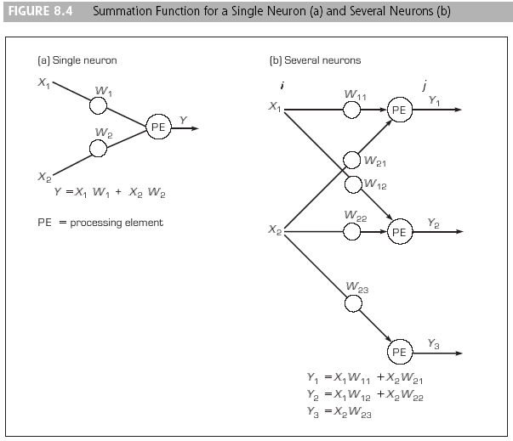
Basic Concepts of Neural Networks

Slide 16
Basic Concepts of Neural Networks
  Sigmoid (logical activation) function
  An S-shaped transfer function in the range of zero to one
  Threshold value
  A hurdle value for the output of a neuron to trigger the next level of neurons. If an output value is smaller than the threshold value, it will not be passed to the next level of neurons
  Hidden layer
  The middle layer of an artificial neural network that has three or more layers

Slide 17
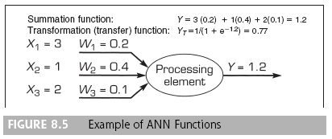
Basic Concepts of Neural Networks

Slide 18
Basic Concepts of Neural Networks
Neural network architectures
  Common neural network models and algorithms include:
  Backpropagation
  Feedforward (or associative memory)
    Recurrent network

Slide 19
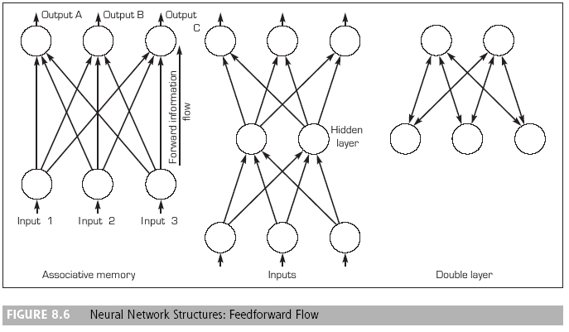
Basic Concepts of Neural Networks

Slide 20
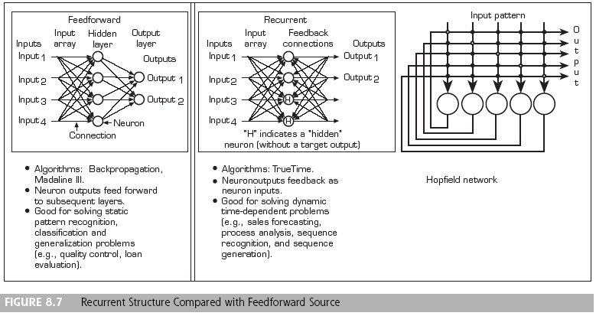
Basic Concepts of Neural Networks

Slide 21
Learning in ANN
  Learning algorithm
  The training procedure used by an artificial neural network

Slide 22
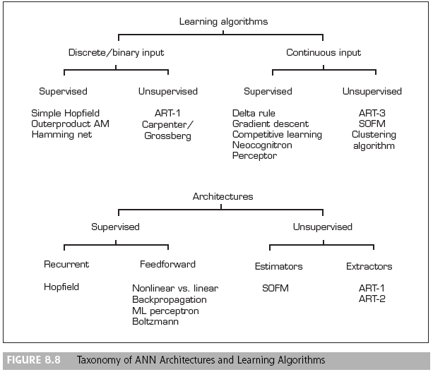
Learning in ANN

Slide 23
Learning in ANN
  Supervised learning
  A method of training artificial neural networks in which sample cases are shown to the network as input and the weights are adjusted to minimize the error in its outputs
  Unsupervised learning
  A method of training artificial neural networks in which only input stimuli are shown to the network, which is self-organizing

Slide 24
Learning in ANN
  Self-organizing
  A neural network architecture that uses unsupervised learning
  Adaptive resonance theory (ART)
  An unsupervised learning method created by Stephen Grossberg. It is a neural network architecture that is aimed at being more brain-like in unsupervised mode
  Kohonen self-organizing feature maps
  A type of neural network model for machine learning

Slide 25
Learning in ANN
  The general ANN learning process
  The process of learning involves three tasks:
    Compute temporary outputs
    Compare outputs with desired targets
    Adjust the weights and repeat the process

Slide 26
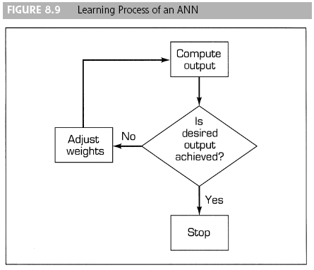
Learning in ANN

Slide 27
Learning in ANN
The general ANN learning process
  The process of learning involves three tasks:
    Compute temporary outputs
    Compare outputs with desired targets
    Adjust the weights and repeat the process

Slide 28
Learning in ANN
  Pattern recognition
  The technique of matching an external pattern to one stored in a computer’s memory; used in inference engines, image processing, neural computing, and speech recognition (in other words, the process of classifying data into predetermined categories).

Slide 29
Learning in ANN
How a network learns
  Learning rate
  A parameter for learning in neural networks. It determines the portion of the existing discrepancy that must be offset
  Momentum
  A learning parameter in feedforward-backpropagation neural networks

Slide 30
Learning in ANN
How a network learns
  Backpropagation
  The best-known learning algorithm in neural computing. Learning is done by comparing computed outputs to desired outputs of historical cases

Slide 31
Learning in ANN
How a network learns
  Procedure for a learning algorithm
    Initialize weights with random values and set other parameters
    Read in the input vector and the desired output
    Compute the actual output via the calculations, working forward through the layers
    Compute the error
    Change the weights by working backward from the output layer through the hidden layers

Slide 32
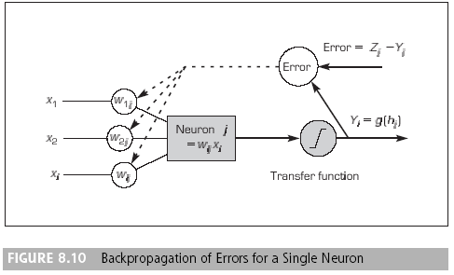
Developing Neural
Network–Based Systems

Slide 33
Developing Neural
Network–Based Systems
Data collection and preparation
  The data used for training and testing must include all the attributes that are useful for solving the problem
Selection of network structure
  Selection of a topology
  Topology
  The way in which neurons are organized in a neural network

Slide 34
Developing Neural
Network–Based Systems
Data collection and preparation
  The data used for training and testing must include all the attributes that are useful for solving the problem
Selection of network structure
  Selection of a topology
  Determination of:
    Input nodes
    Output nodes
    Number of hidden layers
    Number of hidden nodes

Slide 35
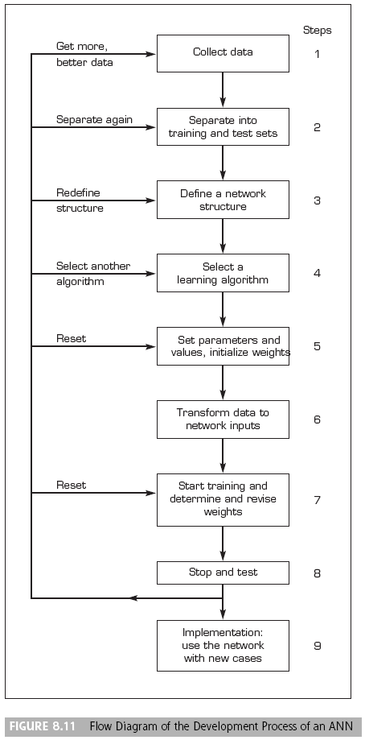
Developing Neural
Network–Based Systems

Slide 36
Developing Neural
Network–Based Systems
Learning algorithm selection
  Identify a set of connection weights that best cover the training data and have the best predictive accuracy
Network training
  An iterative process that starts from a random set of weights and gradually enhances the fitness of the network model and the known data set
  The iteration continues until the error sum is converged to below a preset acceptable level

Slide 37
Developing Neural
Network–Based Systems
Testing
  Black-box testing
  Comparing test results to actual results
  The test plan should include routine cases as well as potentially problematic situations
  If the testing reveals large deviations, the training set must be reexamined, and the training process may have to be repeated

Slide 38
Developing Neural
Network–Based Systems
Implementation of an ANN
  Implementation often requires interfaces with other computer-based information systems and user training
  Ongoing monitoring and feedback to the developers are recommended for system improvements and long-term success
  It is important to gain the confidence of users and management early in the deployment to ensure that the system is accepted and used properly

Slide 39
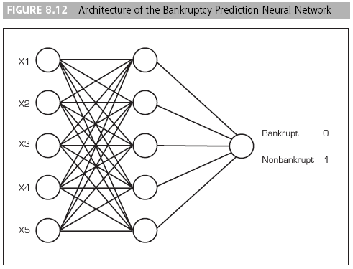
Developing Neural
Network–Based Systems

Slide 40
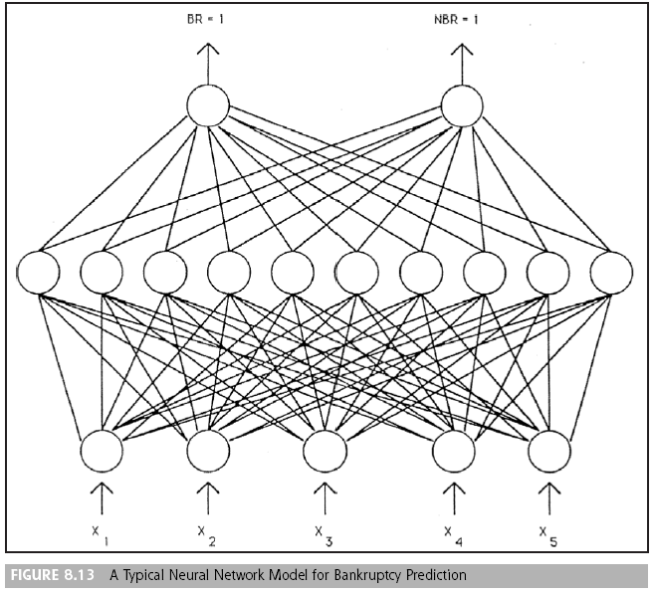
A Sample Neural Network Project

Slide 41
Other Neural Network Paradigms
Hopfield networks
  A single large layer of neurons with total interconnectivity—each neuron is connected to every other neuron
  The output of each neuron may depend on its previous values
  One use of Hopfield networks: Solving constrained optimization problems, such as the classic traveling salesman problem (TSP)

Slide 42
Other Neural Network Paradigms
Self-organizing networks
  Kohonen’s self-organizing network learn in an unsupervised mode
  Kohonen’s algorithm forms “feature maps,” where neighborhoods of neurons are constructed
  These neighborhoods are organized such that topologically close neurons are sensitive to similar inputs into the model
  Self-organizing maps, or self organizing feature maps, can sometimes be used to develop some early insight into the data

Slide 43
Applications of ANN
ANN are suitable for problems whose inputs are both categorical and numeric, and where the relationships between inputs and outputs are not linear or the input data are not normally distributed

